Slide 1

Stock Market Prediction
Shane Harris
Adrian Cabreros

Slide 2
Background
Two Strategies used in stock market prediction
Fundamental Analysis
Business Environment, intrinsic value
Technical Analysis
Chart Analysis, Statistical Analysis
We will be using Technical Analysis
Examine time series stock analysis
Problem: We want to predict future trends of stocks
Approach: Use Deep Learning Models to predict stock prices based on news data and attribute data of company’s finances

Slide 3

Data Collection

Slide 4
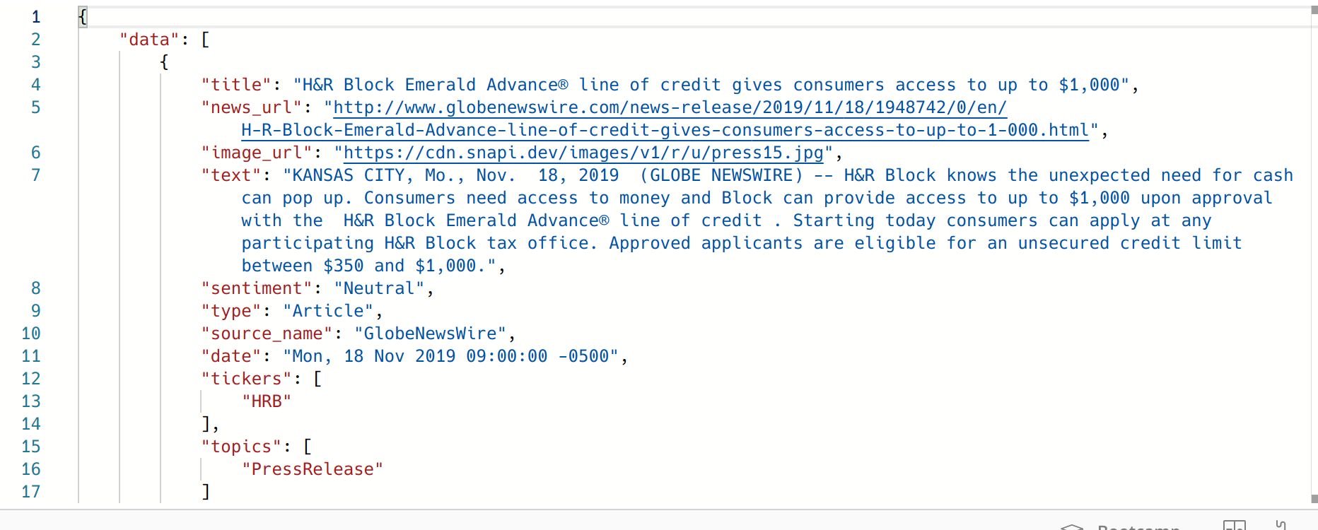
Data Collection: News Articles and Sentiment

Slide 5

Data Collection: TradingView

Slide 6
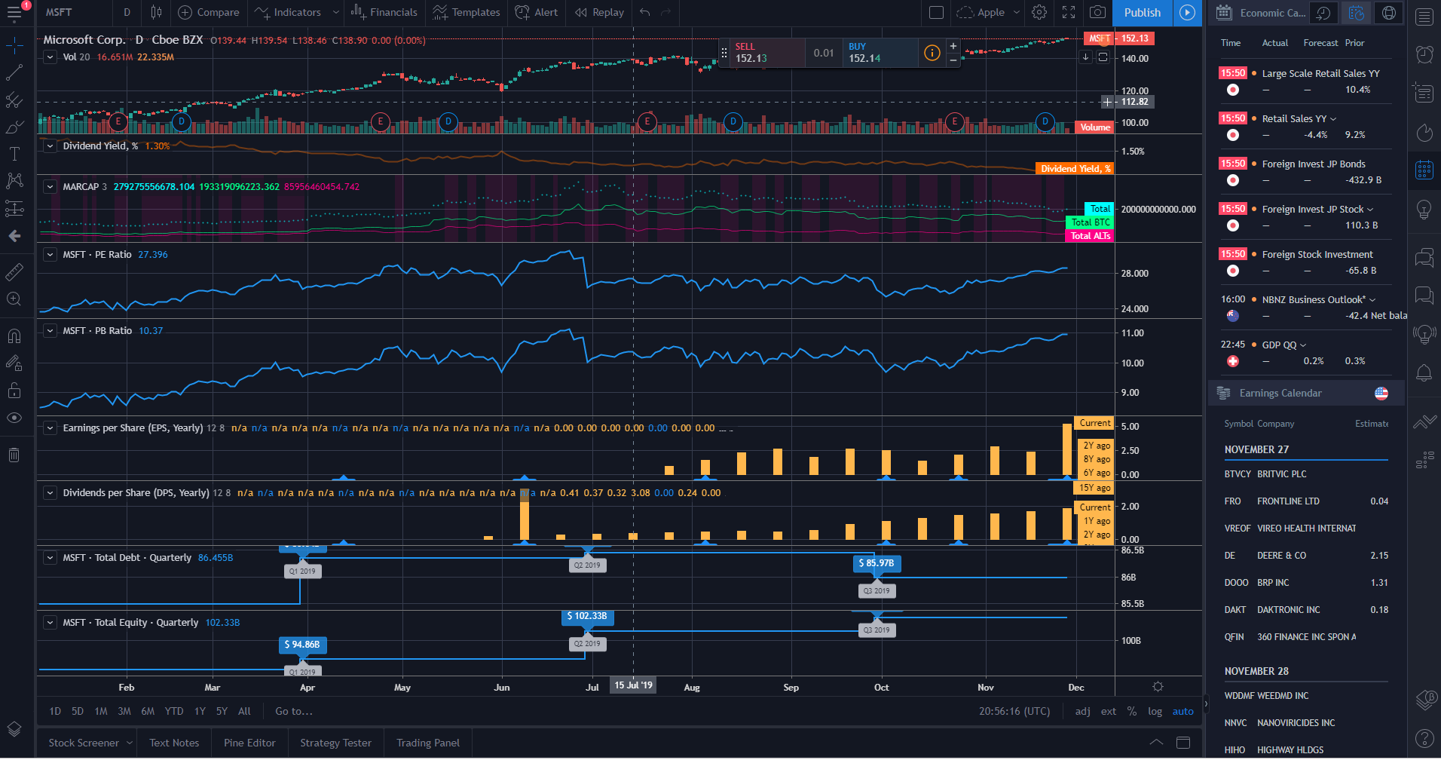
Data Collection: TradingView

Slide 7
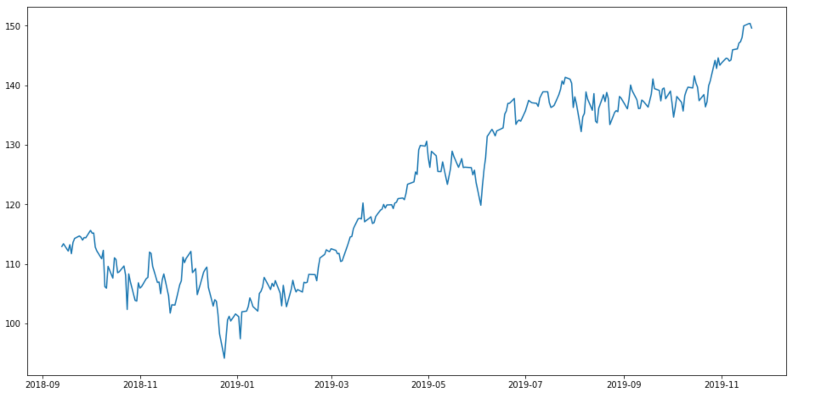
What trends look like over a year

Slide 8
Data Preprocessing
TF-IDF text articles and news article titles of companies
Normalize stock data of companies using min max
One hot encode categorical features
Sentiment of articles
Stock Symbol
Combining data and filtering out duplicates

Slide 9

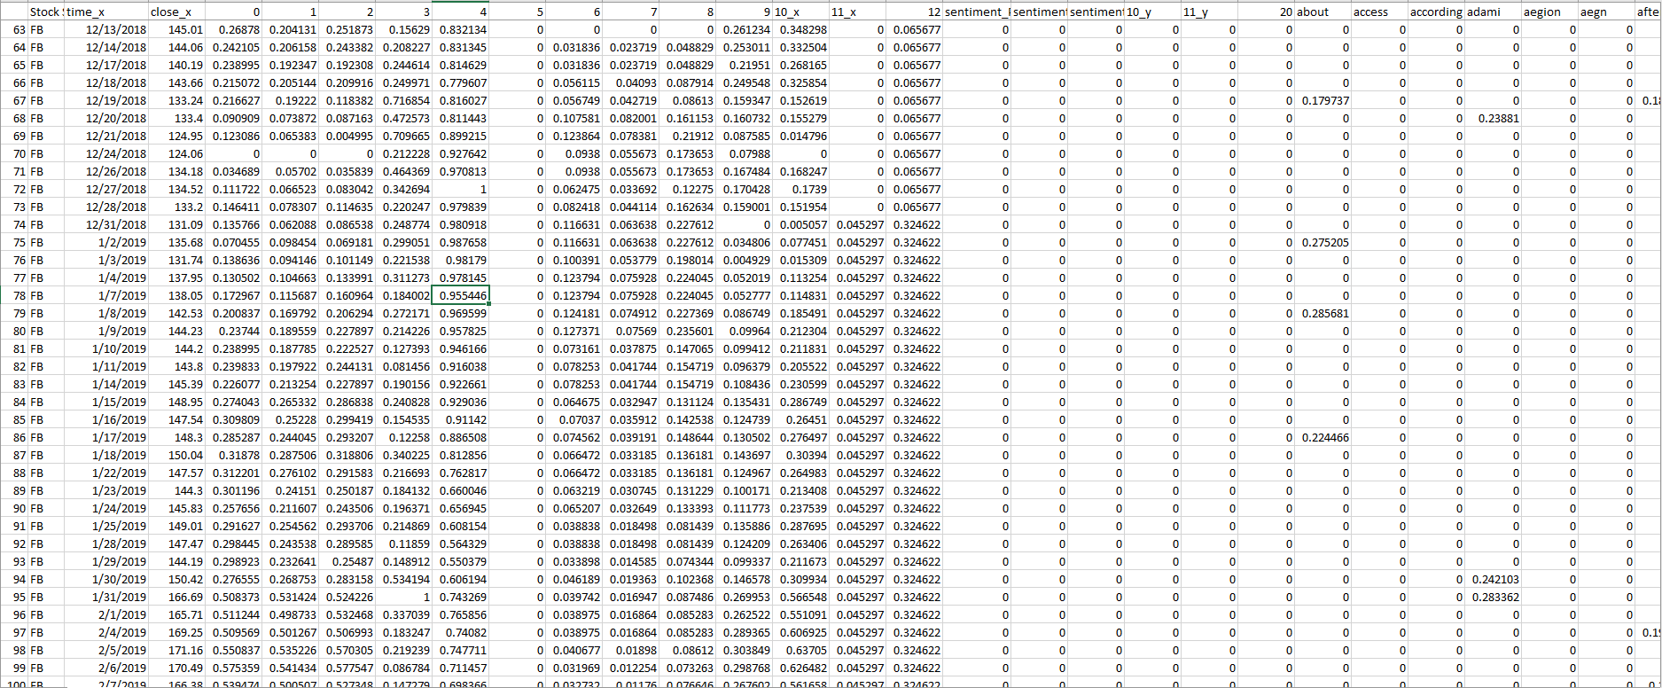
Processed data

Slide 10
Long Short Term Memory Model
Long Short Term Memory Model
Used for sequential data time series to predict future trends
Will keep track of past events and take it into account for future events
Layers
Two Hidden Layers
One Output layer
Adam Optimizer
Trained on different epochs (1 to 5)
Used 45 companies

Slide 11
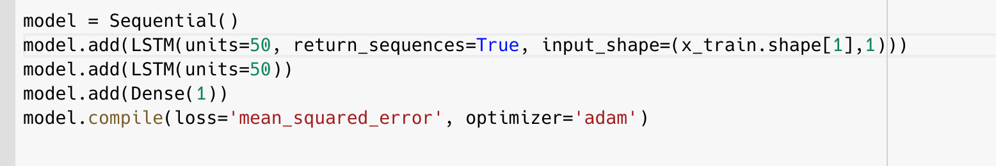
Model Shape

Slide 12
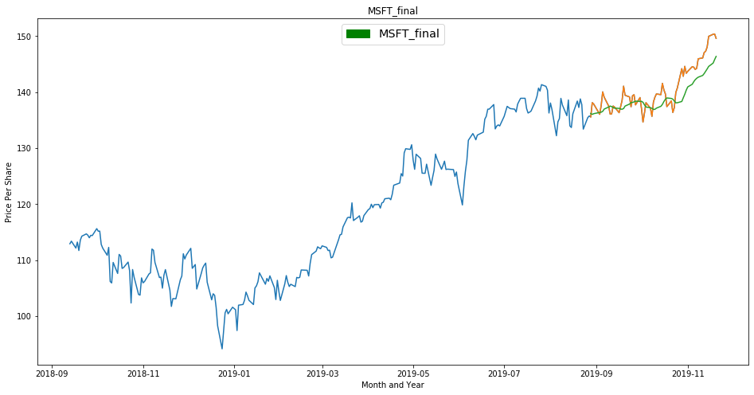
Prediction on one company Microsoft

Slide 13
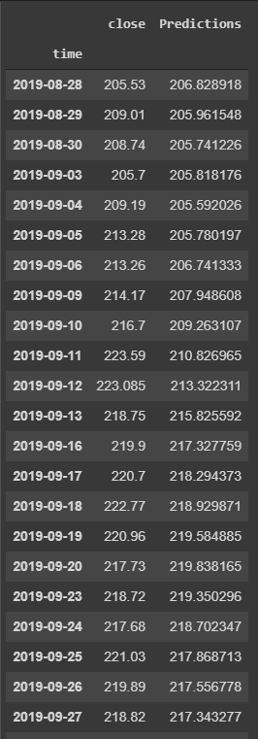
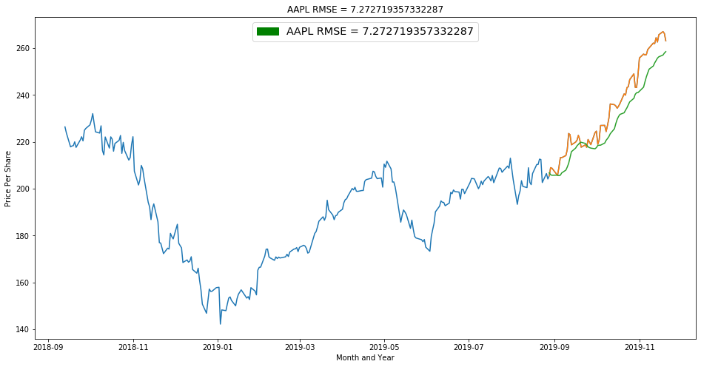
Prediction for Apple

Slide 14
Results
As we fit the model with more companies the prediction becomes more accurate on a granular scale
The shape of the prediction closely resembles the shape of the actual data

Slide 15
Conclusion
It seems that when we attempt to train the model using multiple stocks the datasets that did not include the TF-IDF allowed the model to become better at generalizing stocks
When the same procedure was done with a dataset that included the TF-IDF data from news articles. We found that the model was unable to generalize multiple stocks. However the model was very accurate in learning any singular stock.

Slide 16
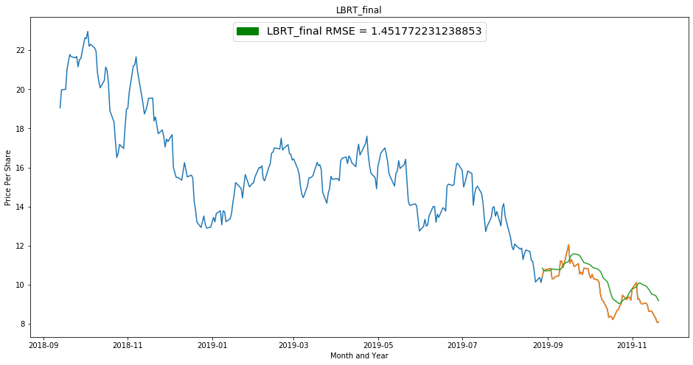
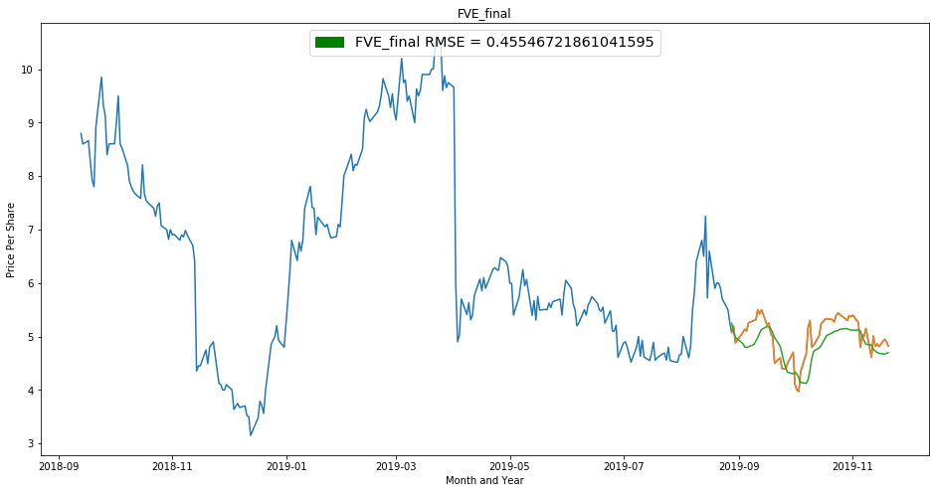
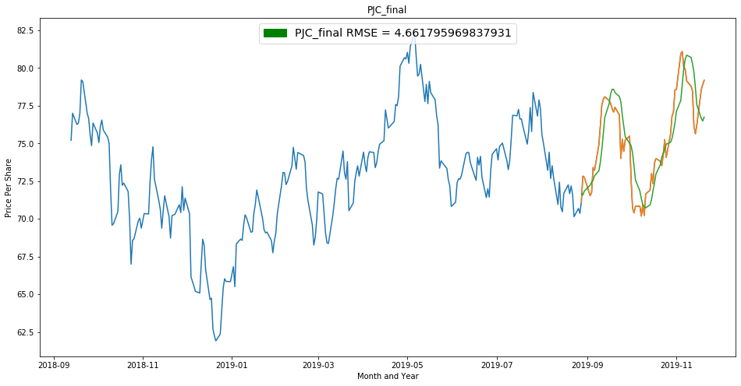
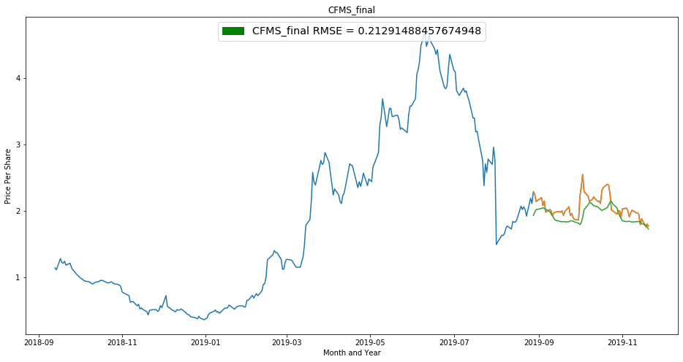

Slide 17
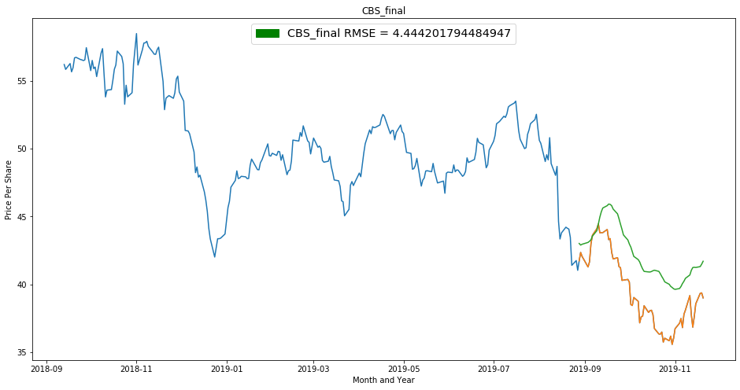
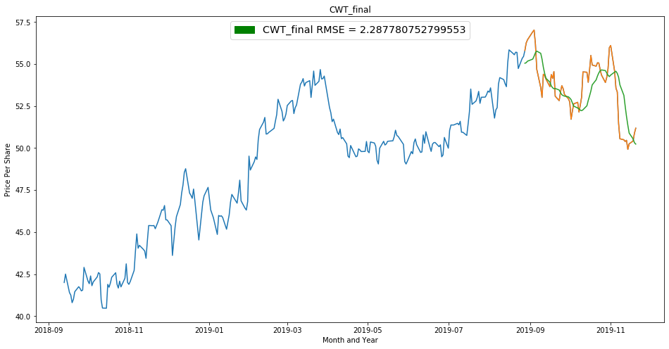
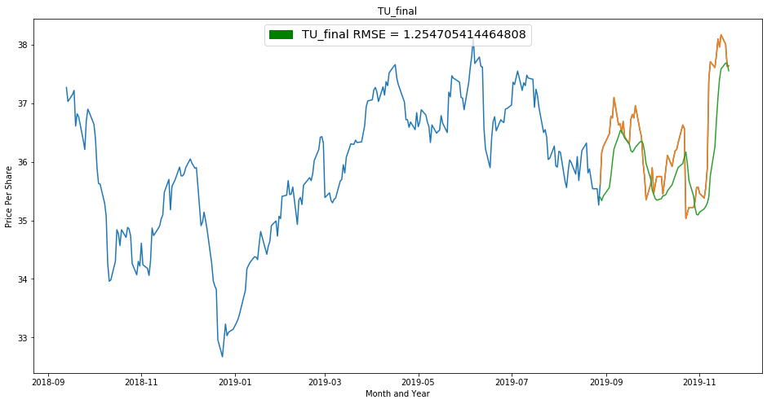
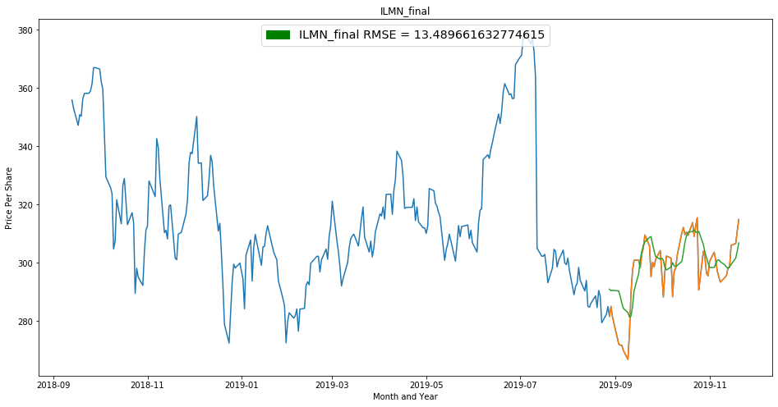

Slide 18
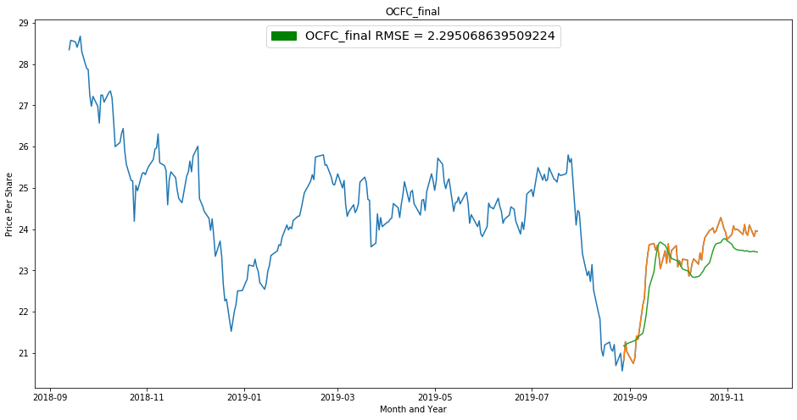
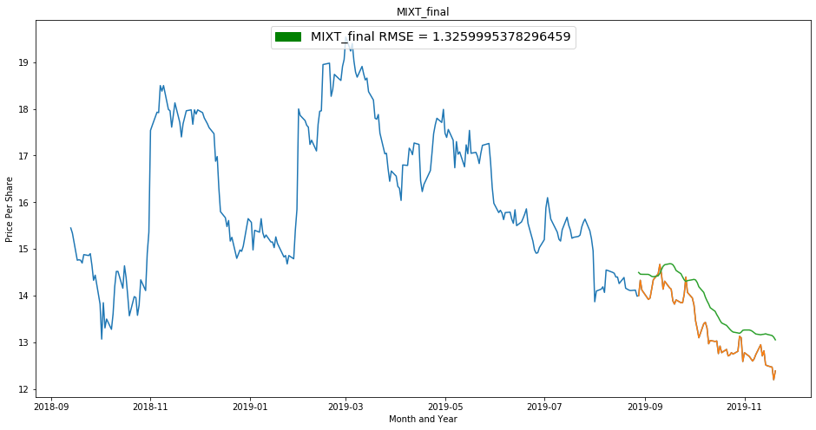
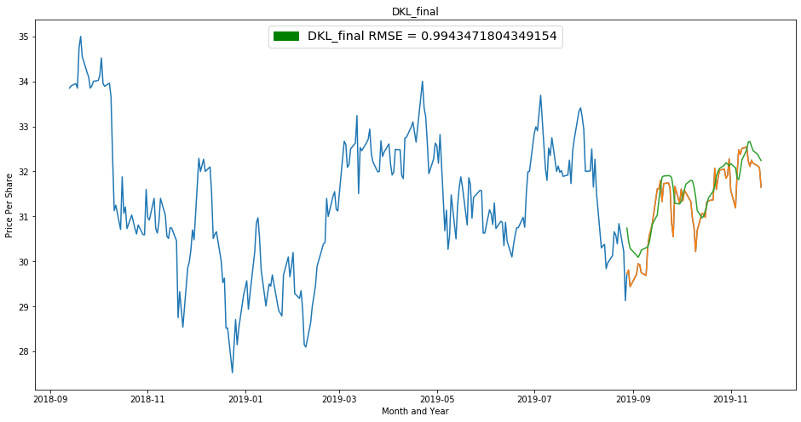
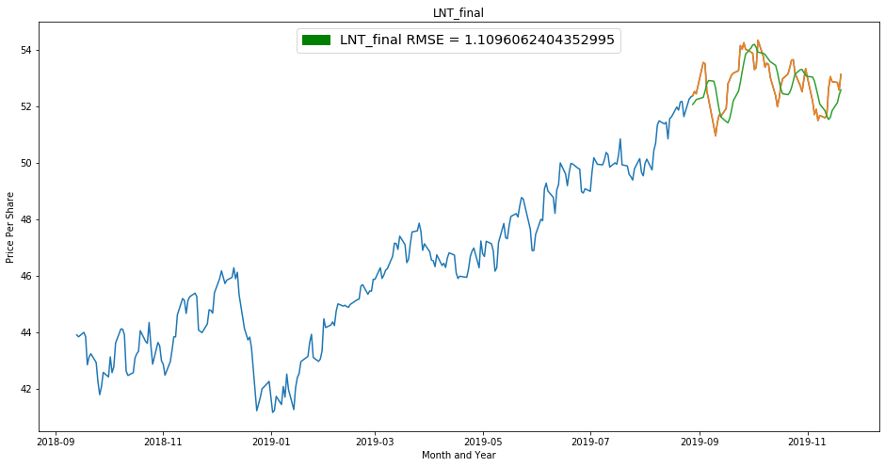

Slide 19
